Slide 1
Office 365 Development

Slide 2


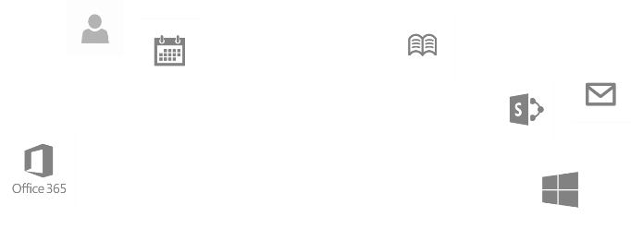
Recap
Deep Dive into Integrating Office 365 APIs with Web Applications
Module 1: Deep Dive into Azure AD with the Office 365 APIs
Module 2: Deep Dive into Office 365 APIs for Calendar, Mail, and Contacts
Module 3: Deep Dive into Office 365 APIs for OneDrive for Business
Module 4: Deep Dive into Office 365 APIs for SharePoint Site services
Module 5: Deep Dive into Office 365 APIs for Yammer services
Module 6: Deep Dive into Office 365 APIs for Office Graph
Module 7: Deep Dive into Office 365 APIs for OneNote services
dev.office.com/training

Slide 3
This Course Agenda
Deep Dive into Integrating Office 365 APIs with mobile device development
Module 1: Universal Windows App Development with Office 365 APIs in Visual Studio 2013
Module 2: Cordova Development with Office 365​ APIs in Visual Studio 2013
Module 3: Xamarin Development with Office 365 APIs in Visual Studio 2013

Slide 4
Xamarin Development with Office 365 APIs in Visual Studio 2013
Speaker
Speaker

Slide 5

Agenda
Xamarin Development Overview
Developing Xamarin Apps
Developing for Office 365
Creating Shared Projects

Slide 6
Xamarin Development Overview

Slide 7
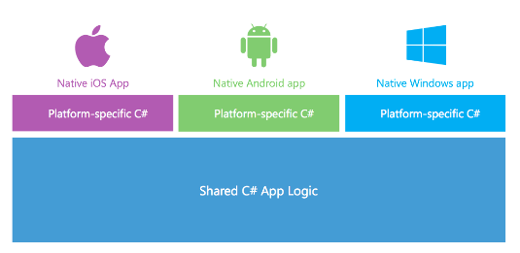
What is Xamarin?
A Company and a Development Platform
Developing on Xamarin platform requires monthly or yearly subscription
You can get a free 30-day trial (90-day trial available for MSDN subscribers)
Xamarin Development based on the .NET framework
You write code using C# and the .NET framework class libraries
Xamarin Platform supported across many OSs and devices
Android
iOS and Mac
Windows and Windows Phone

Slide 8
.NET on Android and iOS
CLR and .NET created for Windows
CLR ported to Linux with Mono project
Mono extended to Android and iOS
iOS
MonoTouch
Windows OS
Linux
CLR & .NET
Mono
CLR & .NET
Android
Mono for Android

Slide 9
Evolution of the Xamarin Platform
Xamarin Platform’s Key Value Proposition
Provide update-to-date versions of .NET on Xamarin.iOS and Xamarin.Android
Allow you to leverage skills you already have with Visual Studio, C# and .NET
Support latest C# features such as support for async and await
iOS
iOS
MonoTouch
Xamarin.iOS
Linux
Mono
CLR & .NET
Android
Android
Mono for Android
Xamarin.Android

Slide 10
What Problems does Xamarin Solve?
Let’s compare Android, iOS and Windows Phone
Significant differences in toolsets
Significant differences in UI/UX models
Significant differences in execution models
Bringing.NET platform to Android and iOS is difficult
Android and iOS platforms have unique runtime environments
Environments very different from .NET’s Common Language Runtime (CLR)
Environments for Android and iOS significantly difference from each other

Slide 11
Xamarin on Android Architecture
App
.NET APIs
Android
Bindings
MCW
android.*
java.*
Mono Runtime
ACW
Dalvik Runtime
Android Kernel

Slide 12
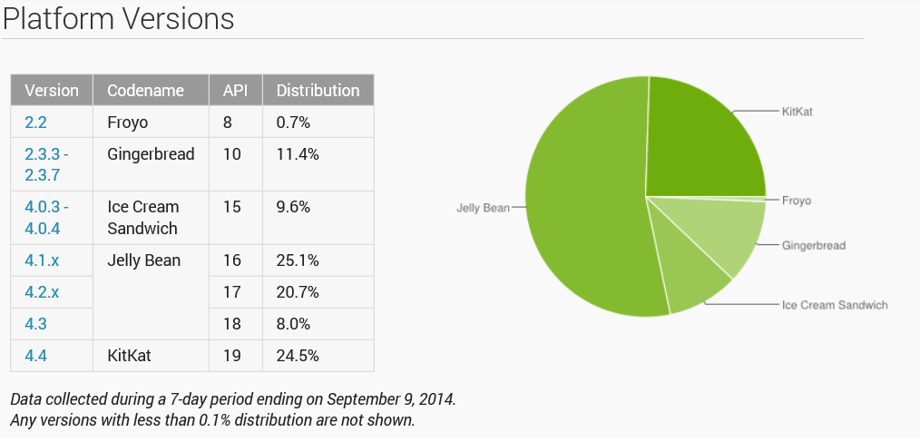
Android usage statistics from http://developer.android.com/about/dashboards/index.html

Slide 13
Xamarin on iOS Architecture
Apple does not allow for runtimes on iOS
App must be packages with everything it needs to run on iOS
Compilation of app must be done on computer with iOS not Windows
App
Application Code
.NET APIs
iOS
Bindings
iOS

Slide 14
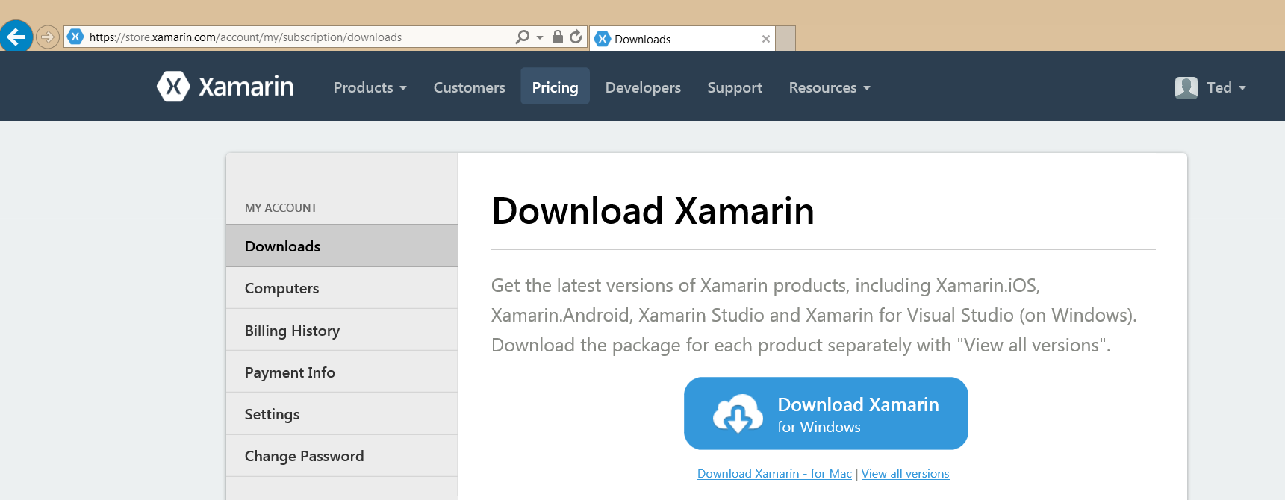
Xamarin Setup
Visual Studio 2013 with Update 3
Install Xamarin

Slide 15
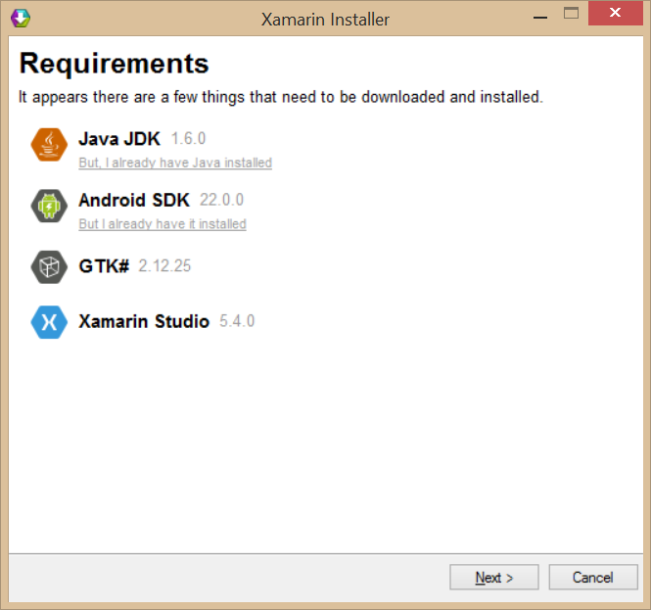
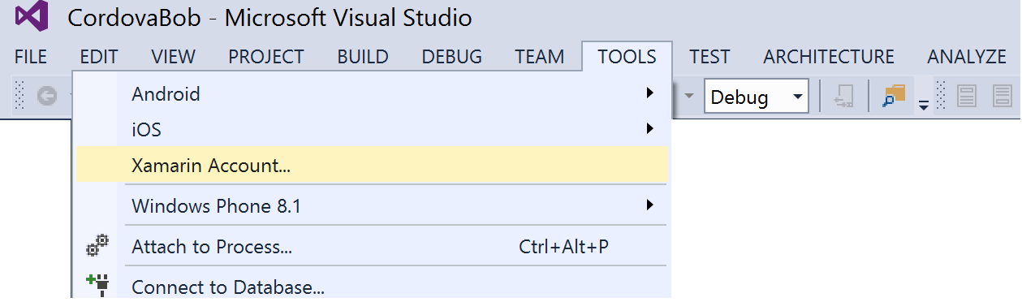
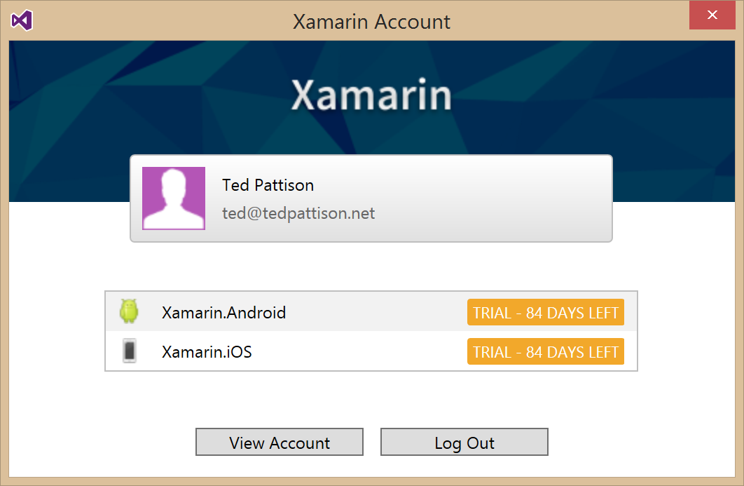
Xamarin Installer
What does it install?
Integration support into Visual Studio
Java JDK
Android SDK
GTK# (UI Toolkit for mono and .NET)
Xamarin Studio

Slide 16
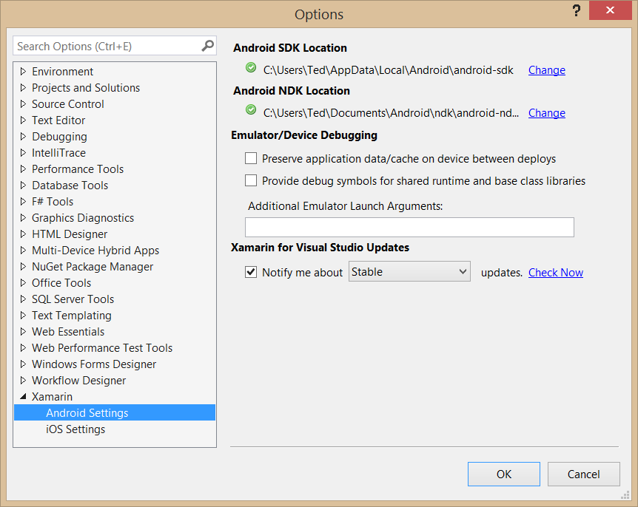
Tools > Options > Xamarin

Slide 17
Developing Xamarin Apps

Slide 18
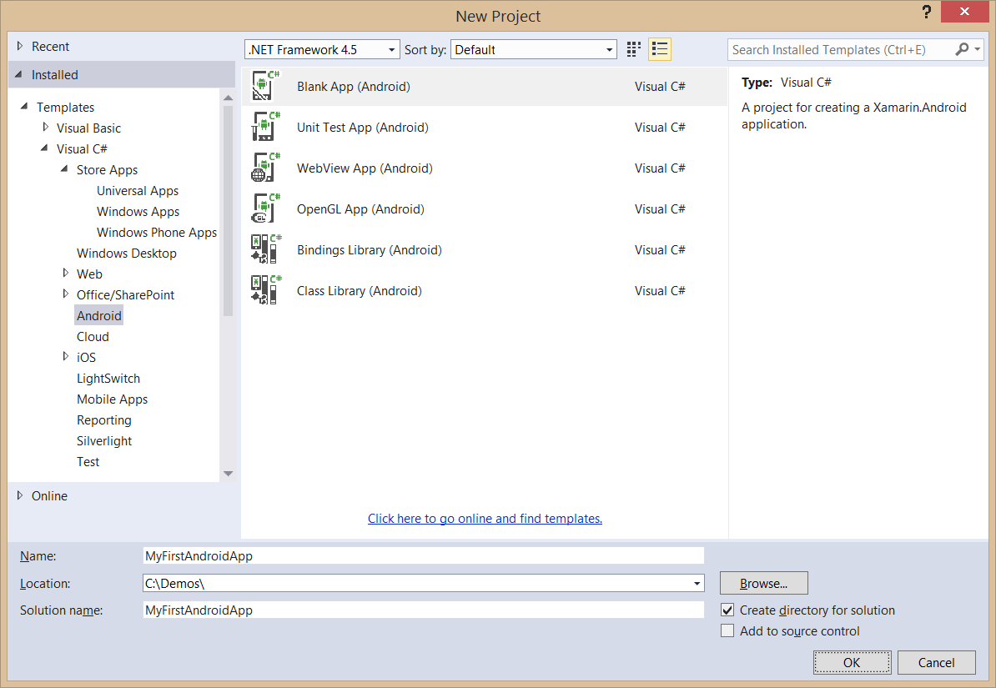
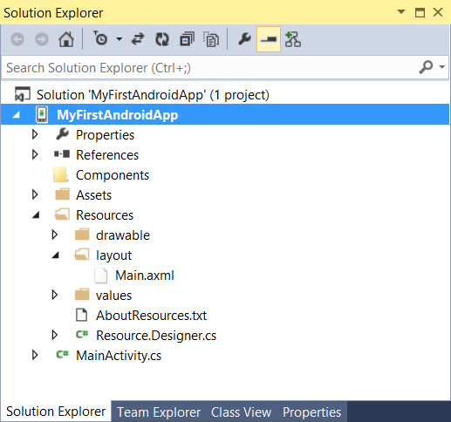
Creating an Android App Project

Slide 19
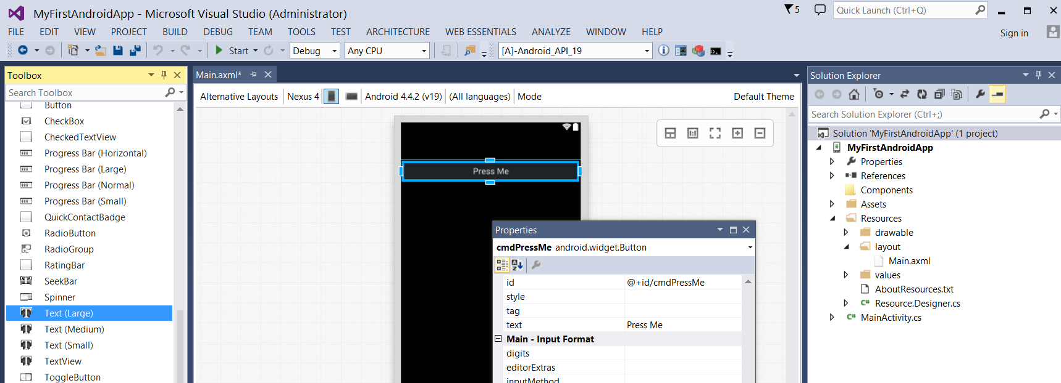
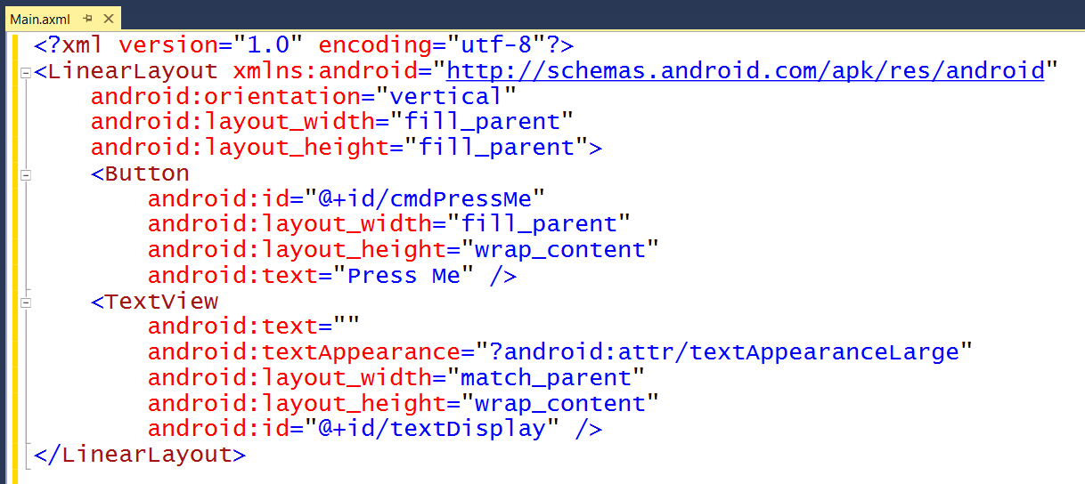
Android Layouts
UI layout decoupled from UI management code
UI Layouts created in XML-based resource files with .axml extensions
Xamarin adds Android layout design editor into to Visual Studio

Slide 20
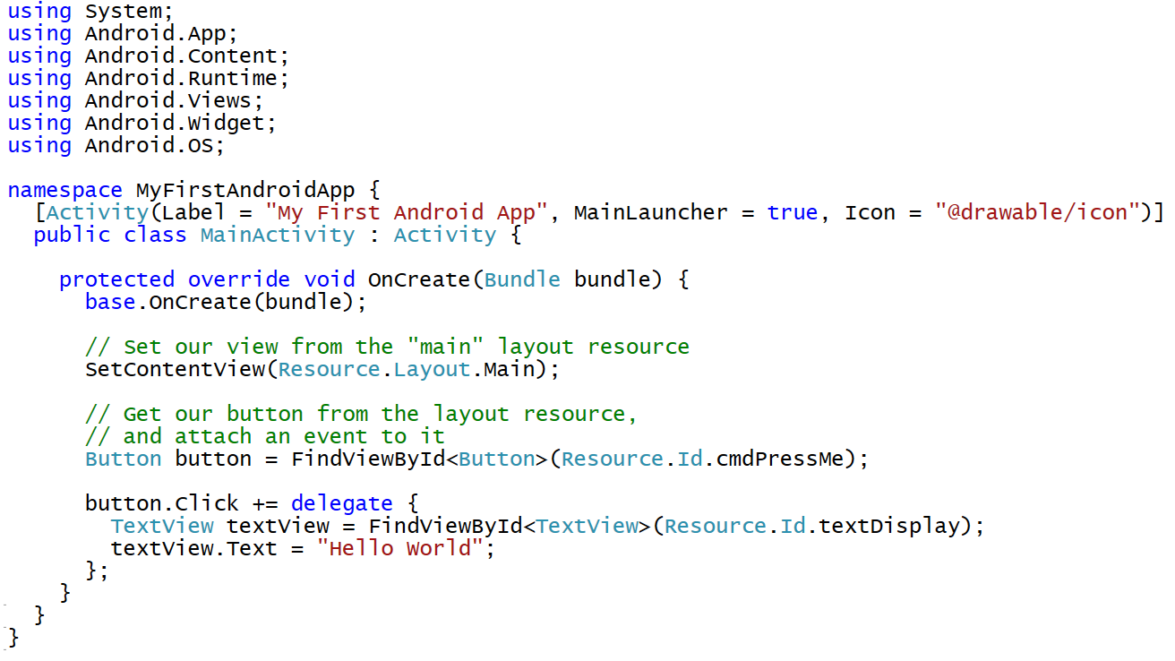
Activity-based User Interface Code

Slide 21
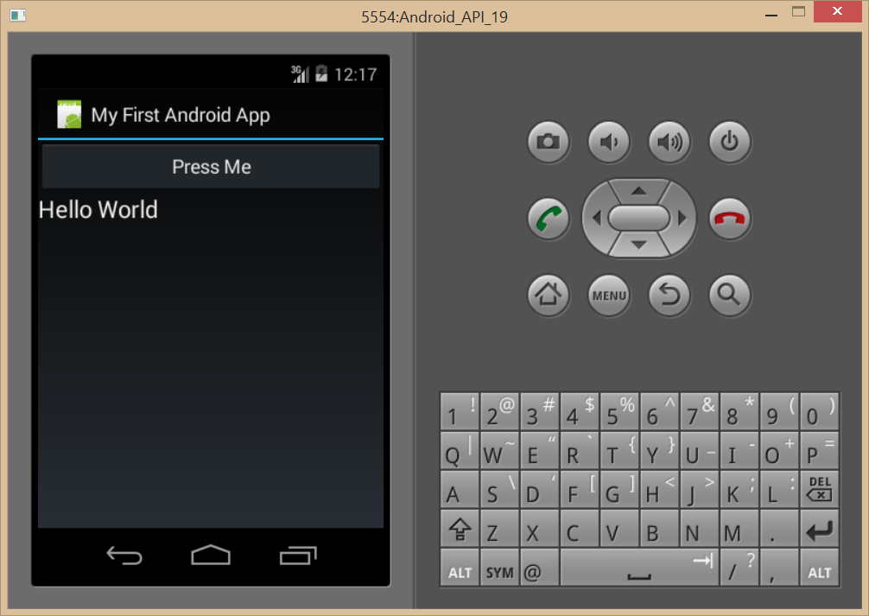
Debugging with an Android Emulator
Android emulators created with Android SDK can be slow
You can optimize performance by installing the Intel HAX module
Intel HAX module requires disabling Hyper-V
http://serena-yeoh.blogspot.com/2014/02/boost-performance-of-android-emulator.html
Use 3rd party emulator such as Genymotion

Slide 22
demo
Creating and Testing an Android App using Xamarin

Slide 23
Developing for Office 365

Slide 24
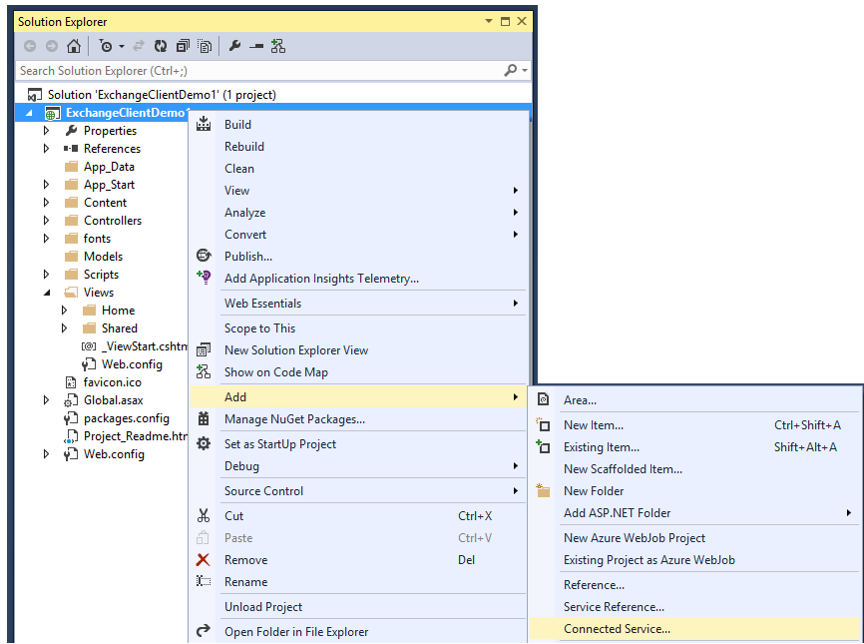
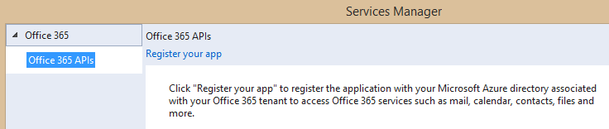
Adding Connected Services
1
Project > Add > Connected Service…
2
Register your app

Slide 25
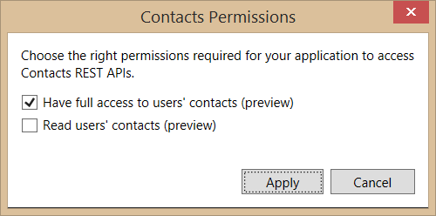
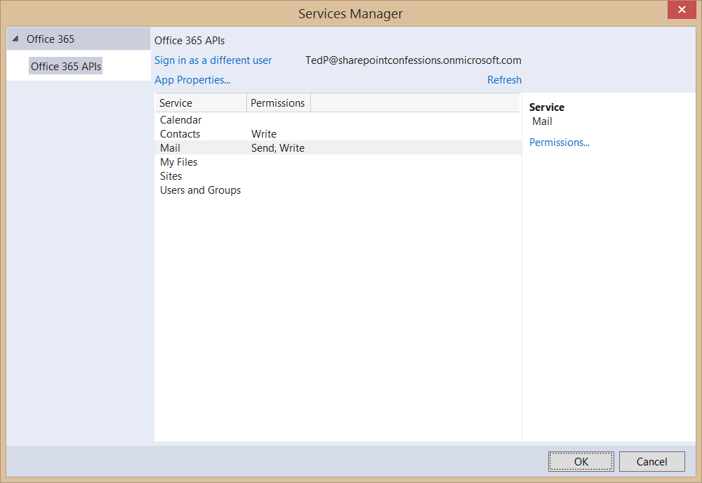
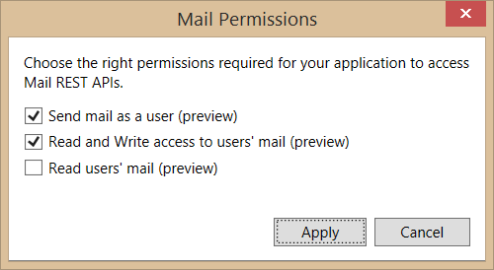
Connected Services Permissions
3
Select required app permissions

Slide 26
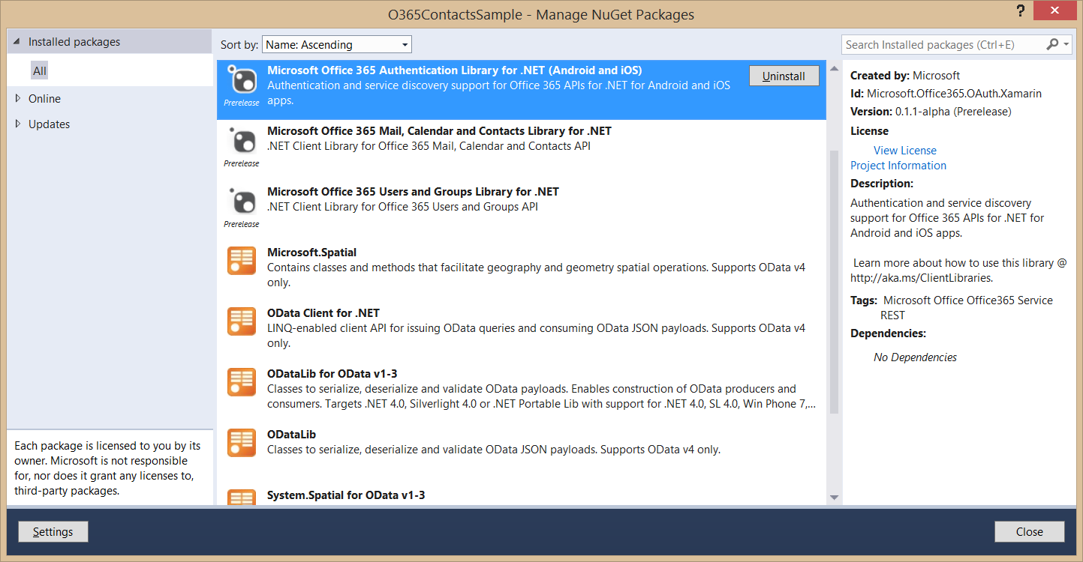
Nuget Packages Added with Connected Services
These packages are added to project when adding a Connected Service

Slide 27
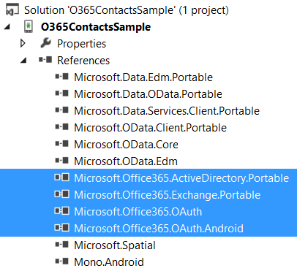
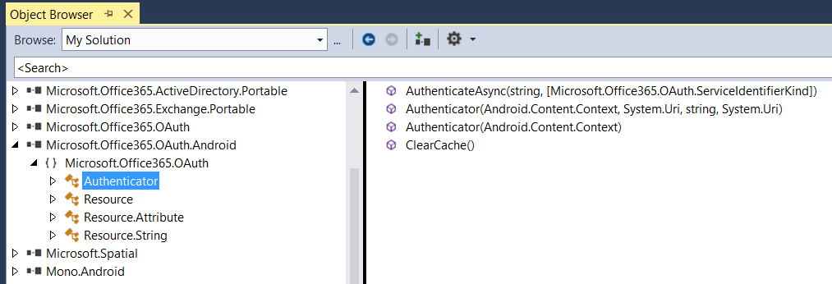
Assemblies Added with Connected Services
These assemblies are added to project when adding a Connected Service

Slide 28
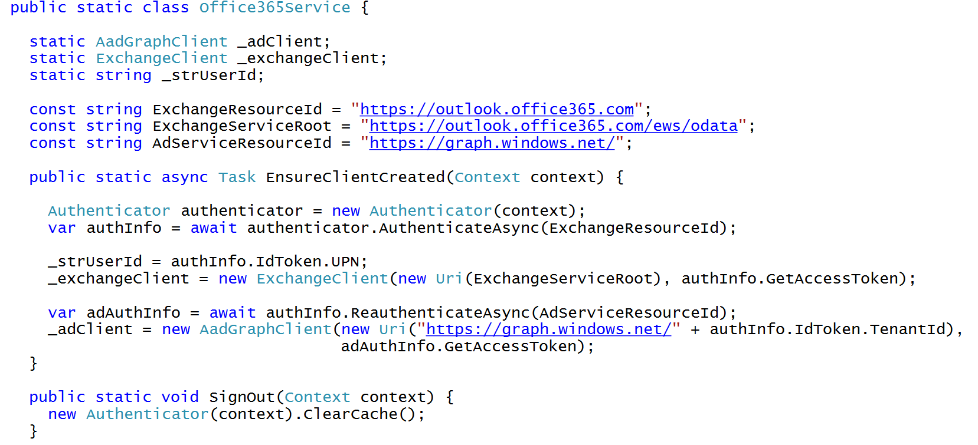
C# Code to Authenticate the User

Slide 29
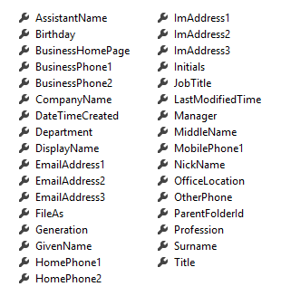
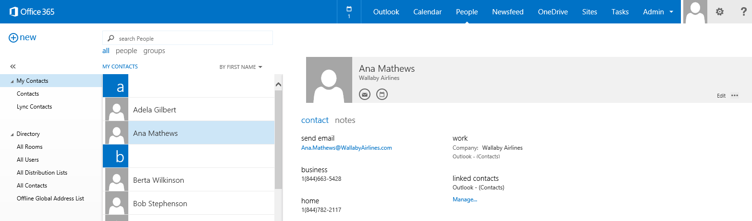
Office 365 Contacts
Common API operations
Reading contacts
Searching for contacts
Creating contacts
Deleting contacts
Editing events
Contact

Slide 30
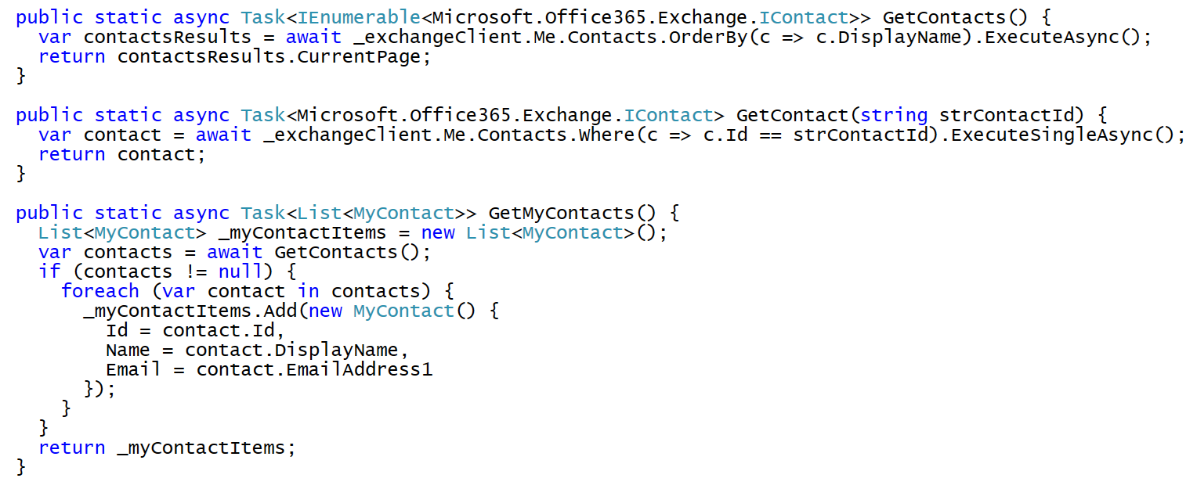
Programming with Office 365 Contacts

Slide 31
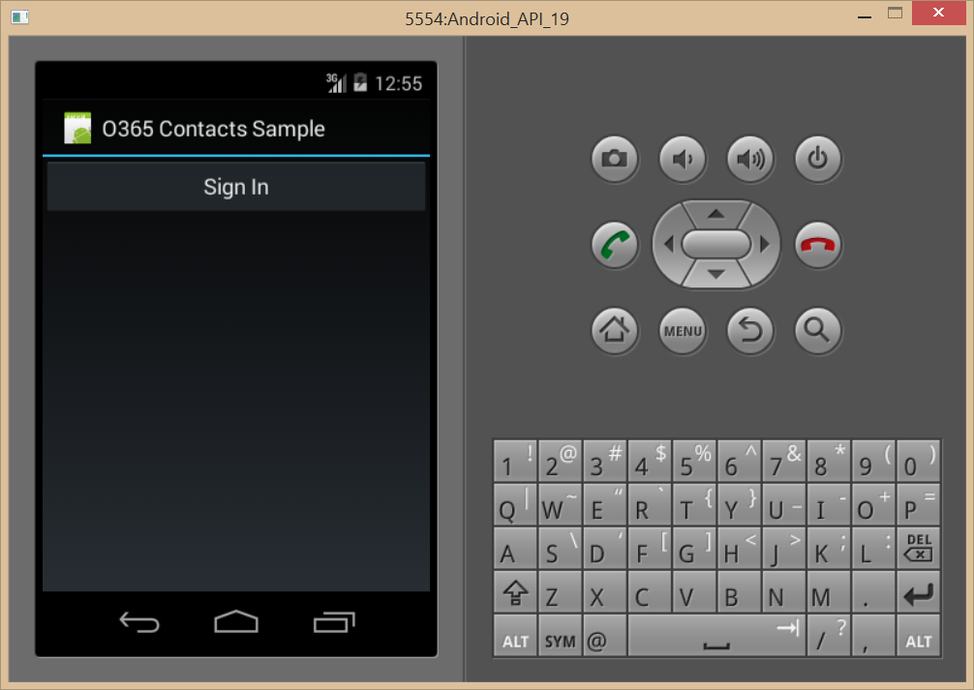
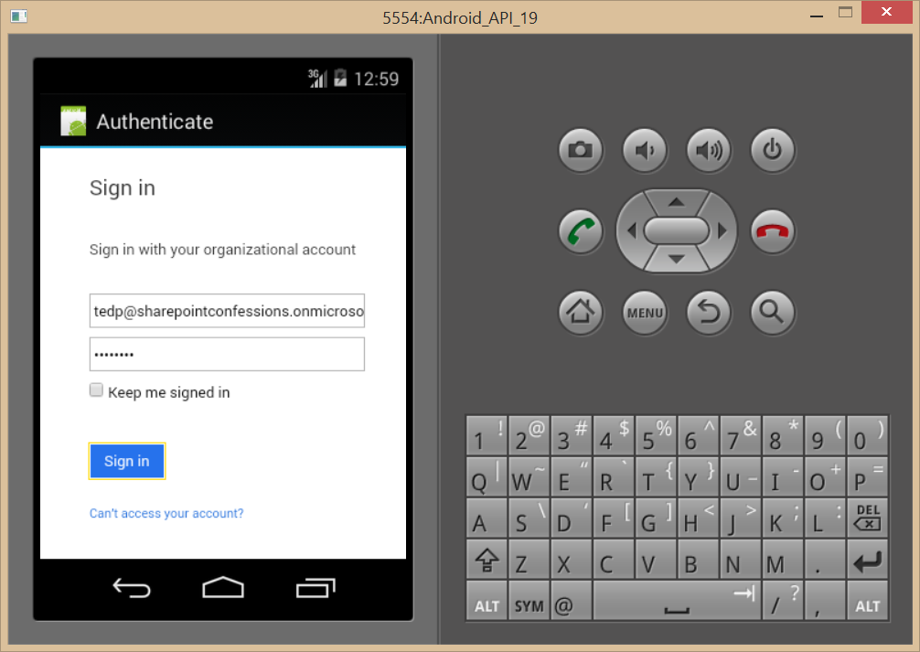
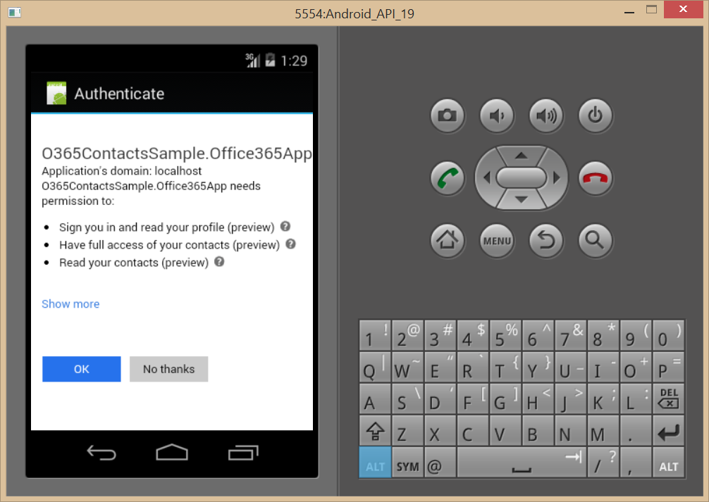
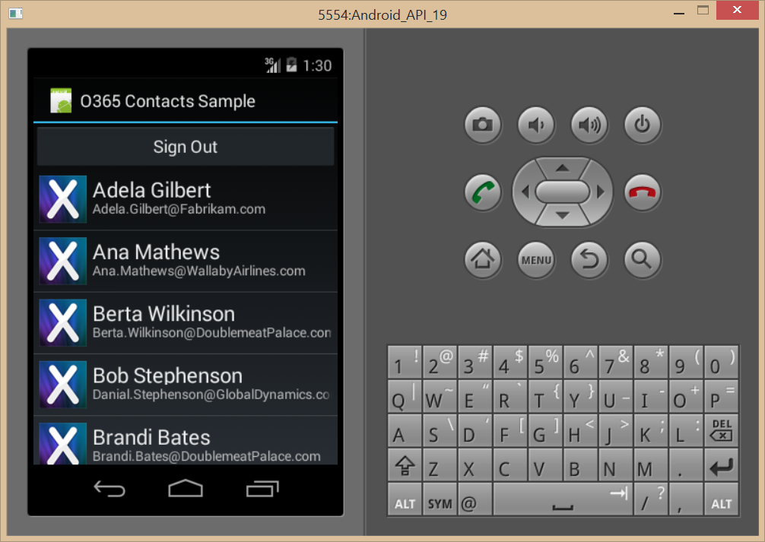
Authentication Flow

Slide 32
demo
Adding A Connected Service to a XAMARIN App

Slide 33
Creating Shared Projects

Slide 34
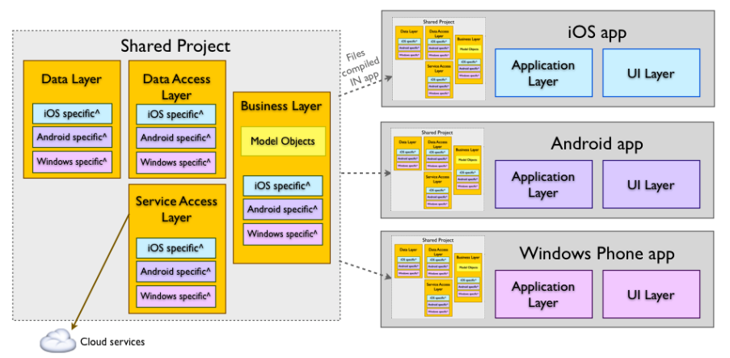
Shared Projects
Allows for reuse of code across projects
Shared project has no output (e.g. DLL) of its own
Shared project code is compiled into any other project that reference it

Slide 35
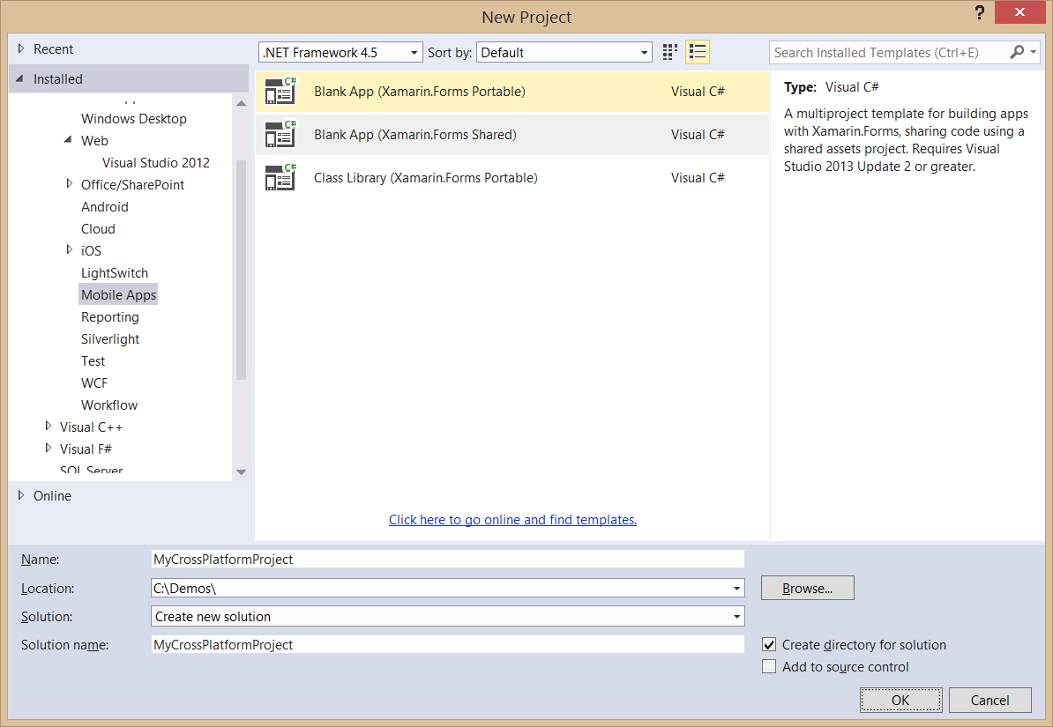
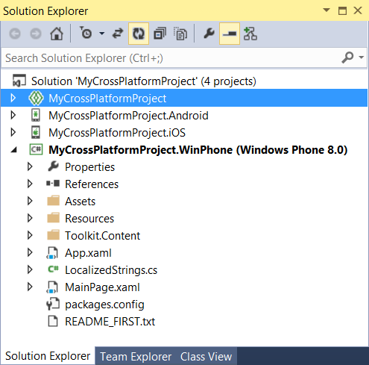
Creating a Shared Project Solution

Slide 36
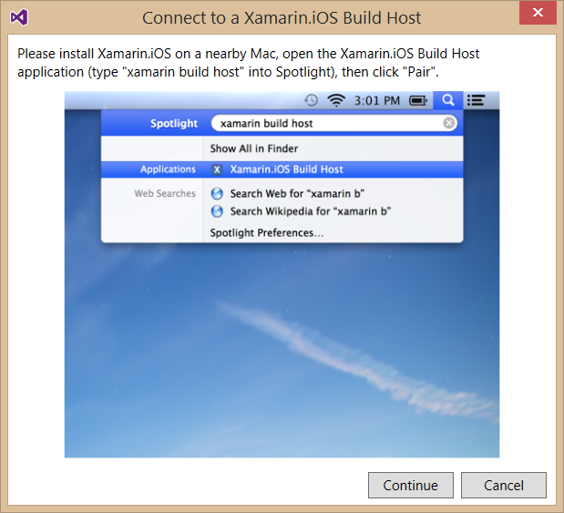
Integrating an iOS Project
To build iOS apps you will needs a Mac
Xamarin product orchestrates communication between Mac and Windows
Windows PC with Visual Studio pairs with Mac computer
Builds and debugging sessions can be initiated from Visual Studio
App compilation done on the Mac

Slide 37
Xamarin.Forms
Cross-platform natively backed UI toolkit abstraction
Allows for UI layouts that can be shared across Android, iOS, and Windows Phone
User interfaces are rendered using the native controls of the target platform
Allows applications to retain the appropriate look and feel for each platform

Slide 38
demo
Examining a Xamarin Cross-Platform Solution

Slide 39
Summary
Xamarin Development Overview
Developing Xamarin Apps
Developing for Office 365
Creating Portable Xamarin Apps

Slide 40
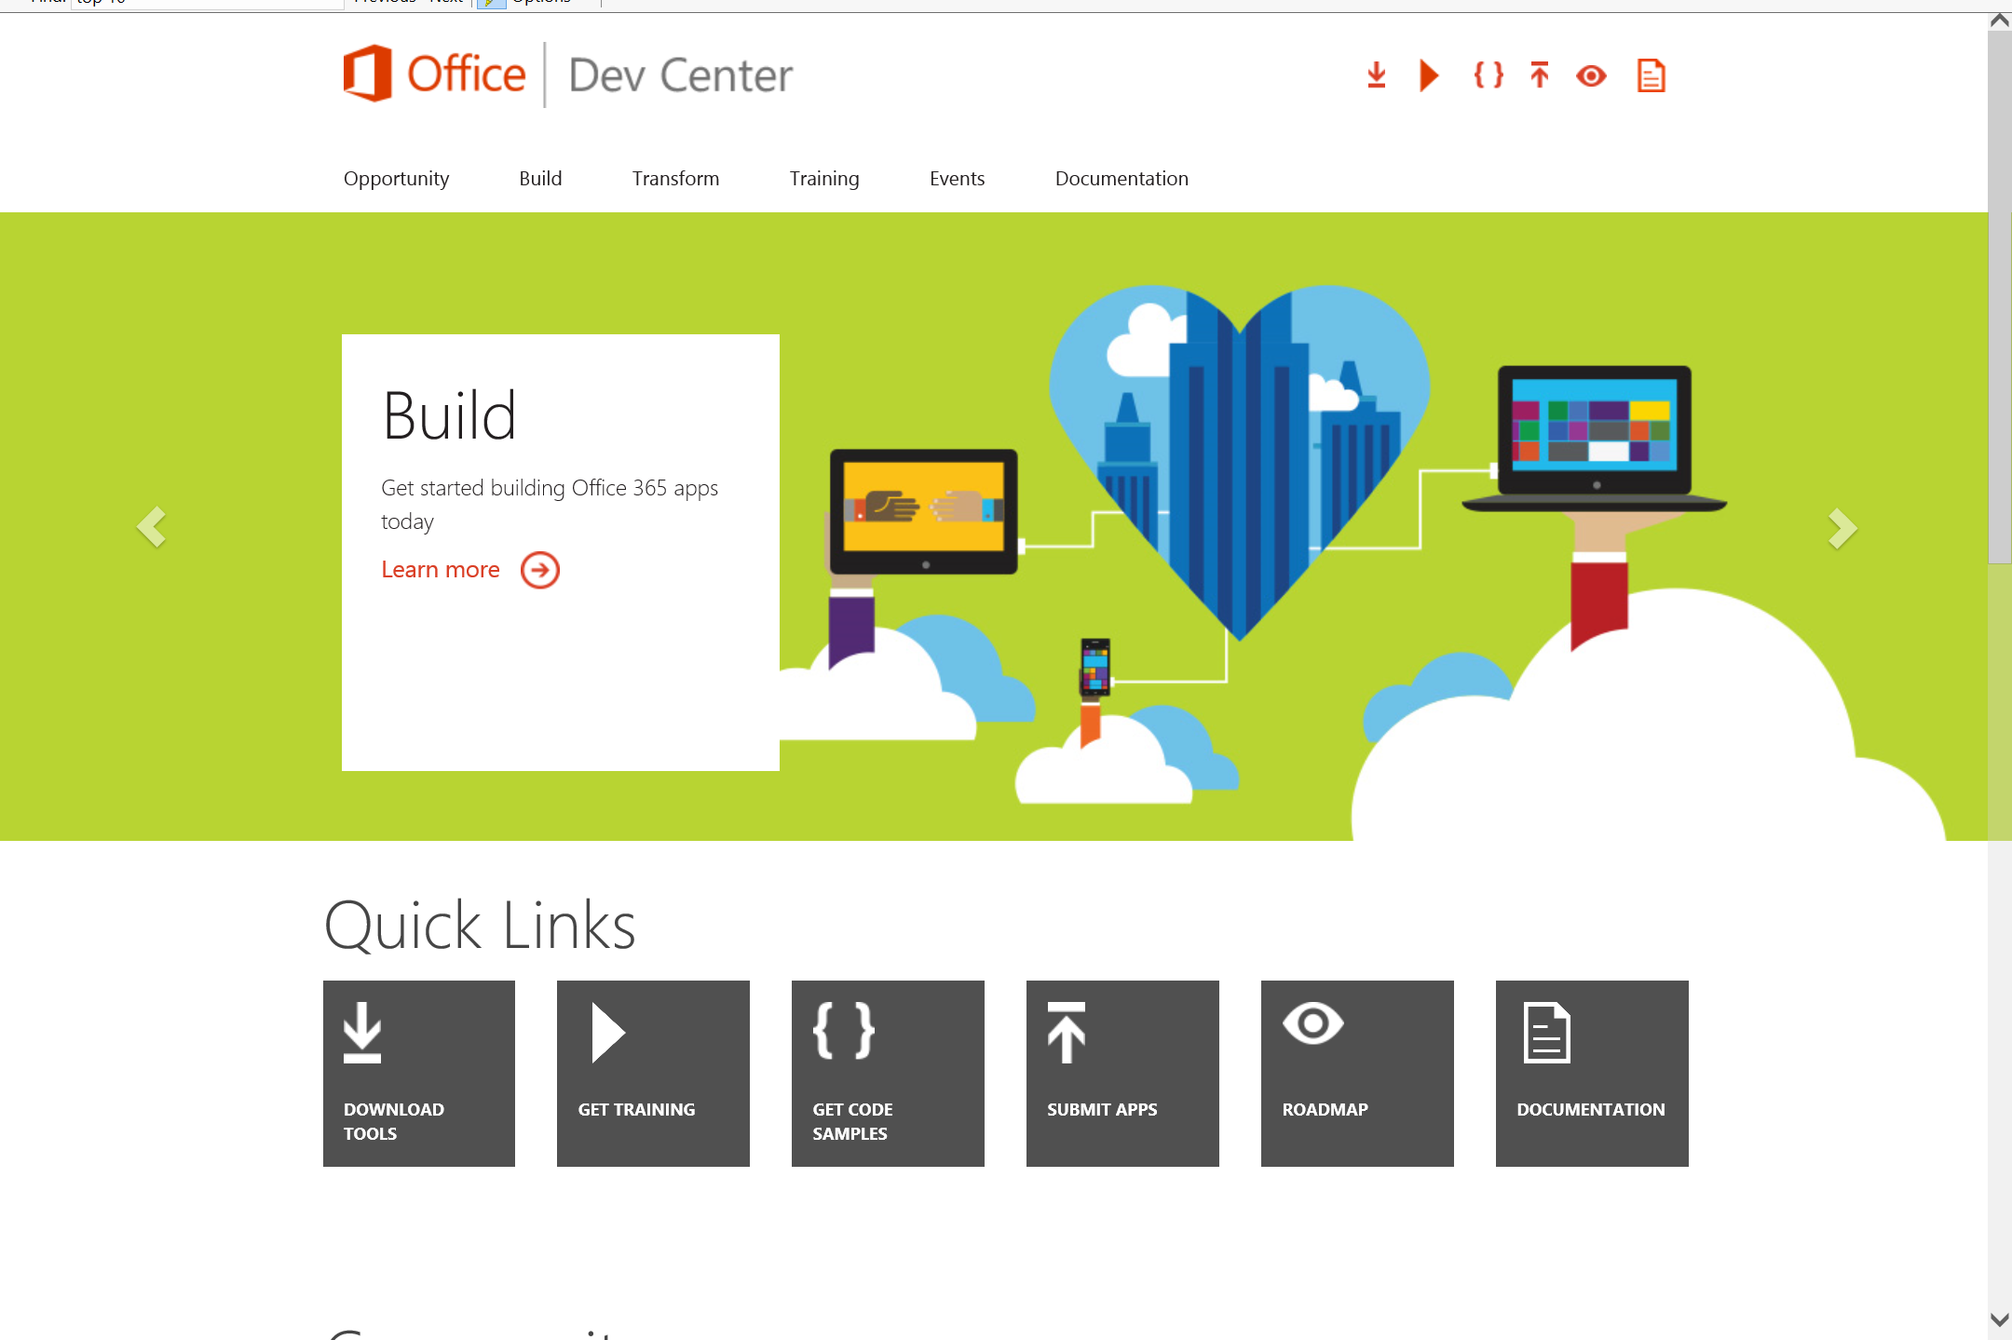
Dev.
Office
.com
One stop shop for Office Developer Platform

Slide 41
Calls to action
Explore our developer center
http://dev.office.com
Jumpstart into our training http://dev.office.com/training
Play with our code samples http://dev.office.com/code-samples
Get answers
http://aka.ms/AskSharePoint
http://aka.ms/AskOffice
Give feedback Drive our roadmap http://aka.ms/OfficeDevFeedback

Slide 42


Transform your code Providing App Model Patterns for common Full Trust Code scenarios
60+ Visual Studio projects Common scenarios
Branding
Site provisioning
Remote event receivers
Large file support
Taxonomy driven navigation
And much more…
Contribute
Open source coming soon!
Developer
Patterns & Practices
aka.ms/OfficeDevPnP

Slide 43
Microsoft Virtual Academy courses
2014
2015
Deep Dive into integrating Office 365 APIs with your mobile device development
Deep dive into the building blocks and services of the SharePoint platform
Deep Dive into integrating Office 365 APIs with your standalone web application development
Introduction to Office 365 Development
Deep Dive into the Office 365 App Model
Deep Dive into Office 365 Development on non-Microsoft Stack
Shipping your Office 365 App to the Office Store
Aug
Sept
Oct
Nov
Dec
Jan
Feb

Slide 44

© 2012 Microsoft Corporation. All rights reserved. Microsoft, Windows, and other product names are or may be registered trademarks and/or trademarks in the U.S. and/or other countries.
The information herein is for informational purposes only and represents the current view of Microsoft Corporation as of the date of this presentation. Because Microsoft must respond to changing market conditions, it should not be interpreted to be a commitment on the part of Microsoft, and Microsoft cannot guarantee the accuracy of any information provided after the date of this presentation. MICROSOFT MAKES NO WARRANTIES, EXPRESS, IMPLIED OR STATUTORY, AS TO THE INFORMATION IN THIS PRESENTATION.

